Slide 1
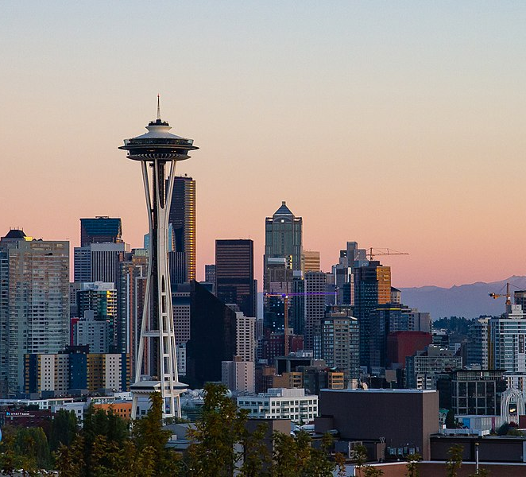
SEATTLE ROAD ACCIDENTS ROSANY ANTONYVINCENT
This Photo by Unknown Author is licensed under CC BY-SA

Slide 2
CONTENTS
THE PROBLEM
DATA CLEANING
DATA ANALYSIS
PREDICTIVE MODELING

Slide 3
THE PROBLEM
Seattle is the largest city in Washington
Road accidents fairly high relative to Washington
High average salary per person – reduce accidents = better for economy

Slide 4
THE DATA
Seattle GeoData from 2004 - 2019
37 attributes
-Missing values/ incomplete data

Slide 5
CLEANING
- Create separate date and time columns, convert to string format
- Extract day, month and hour and put in integer format
-One hot encoding for predictive modelling

Slide 6
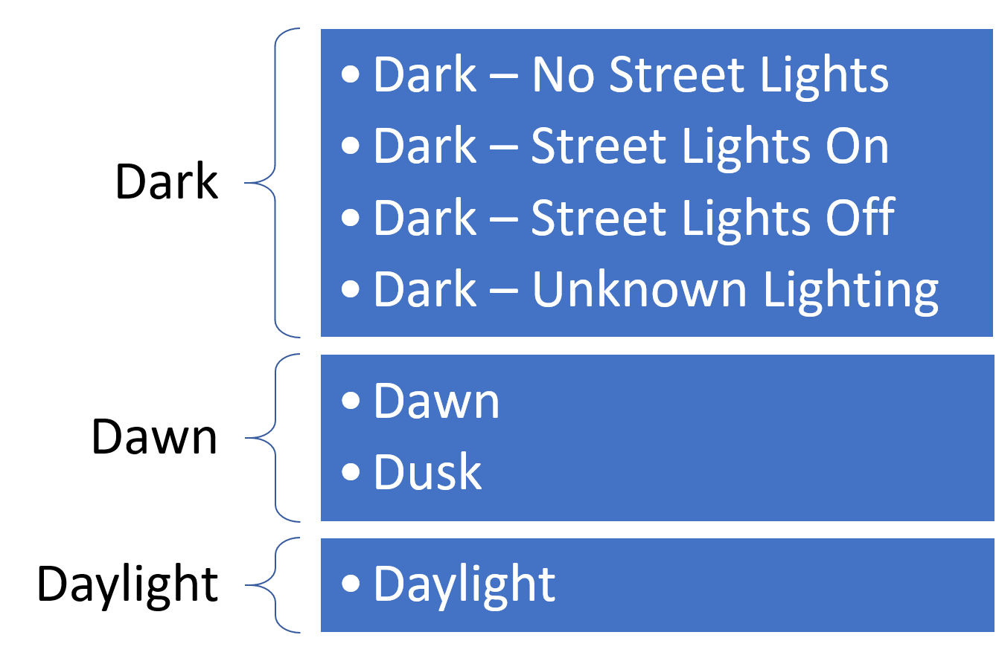
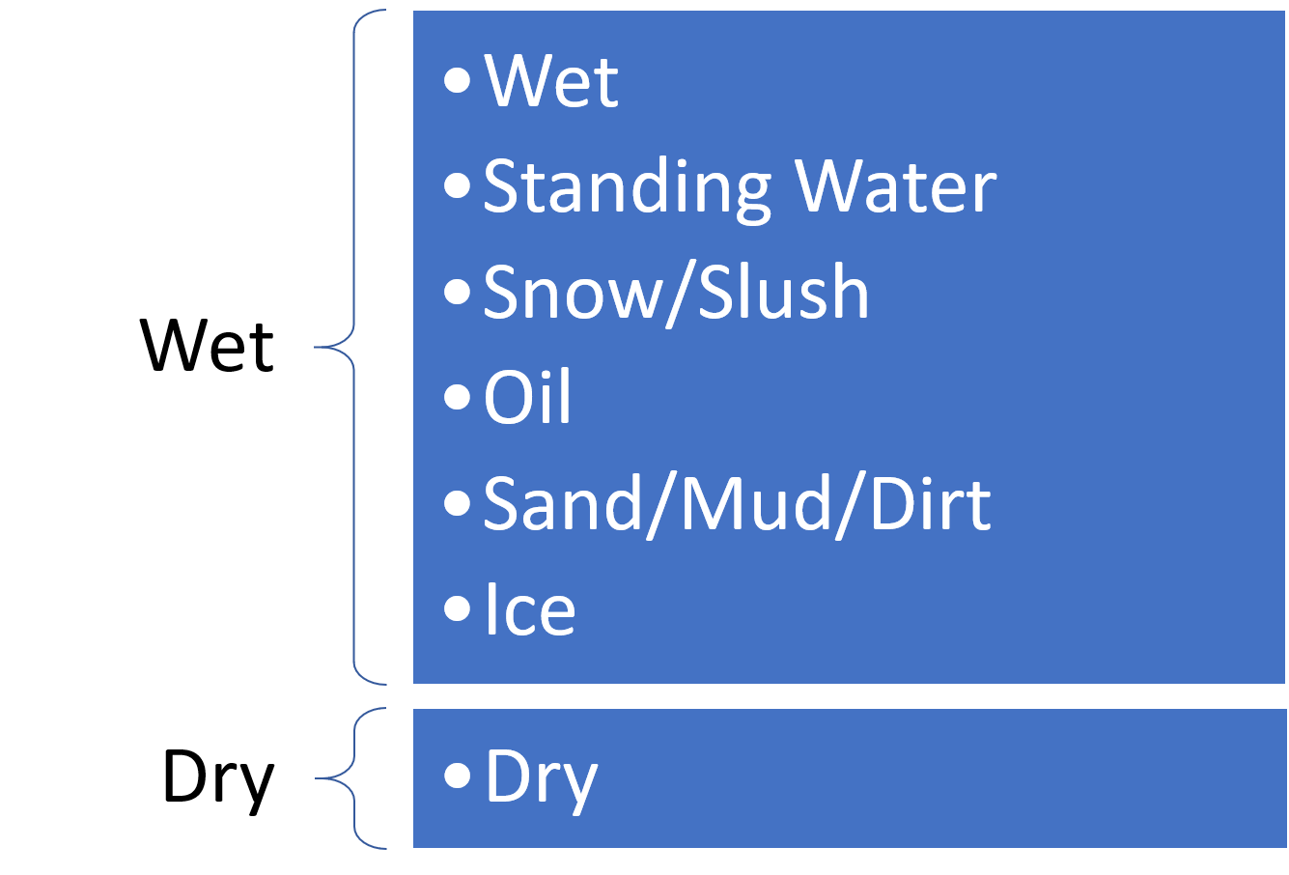
ONE HOT ENCODING

Slide 7
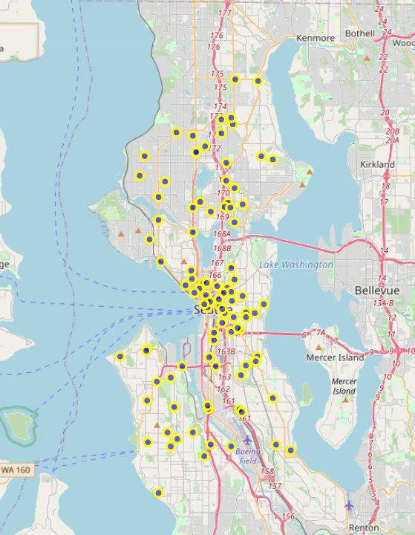
ANALYSIS
Folium map showing the first 1000 datapoints
Accidents fairly spread out with a cluster forming centrally

Slide 8
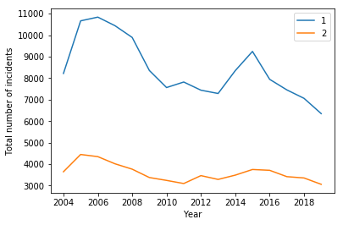
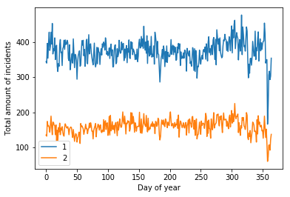
ANALYSIS DATE

Slide 9
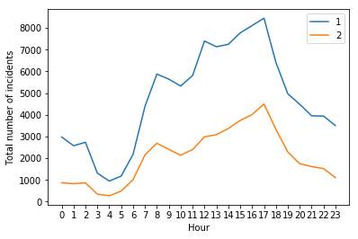
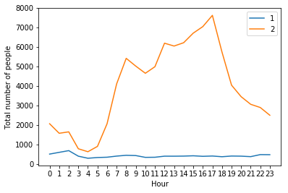
ANALYSIS TIME

Slide 10
PREDICTIVE MODELLING
K nearest neighbours
Decision Tree
Support Vector Machine
Accuracy – Jaccard & F1 score

Slide 11
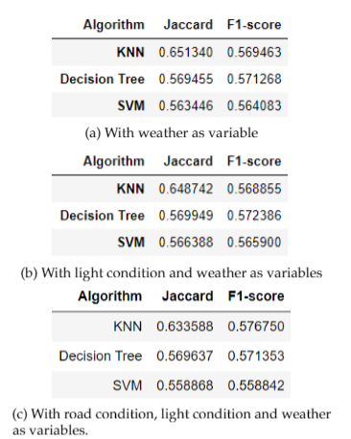
RESULTS
F1-score more accurate
Jaccard index decreases

Slide 12
CONCLUSION
Accuracy fairly even across all models
KNN most accurate
Need to improve runtime and memory so decision tree can run
Analyse location

